Slide 1
Huff Research Group Kendra Andersen
Group Meeting 10/16/17

Slide 2
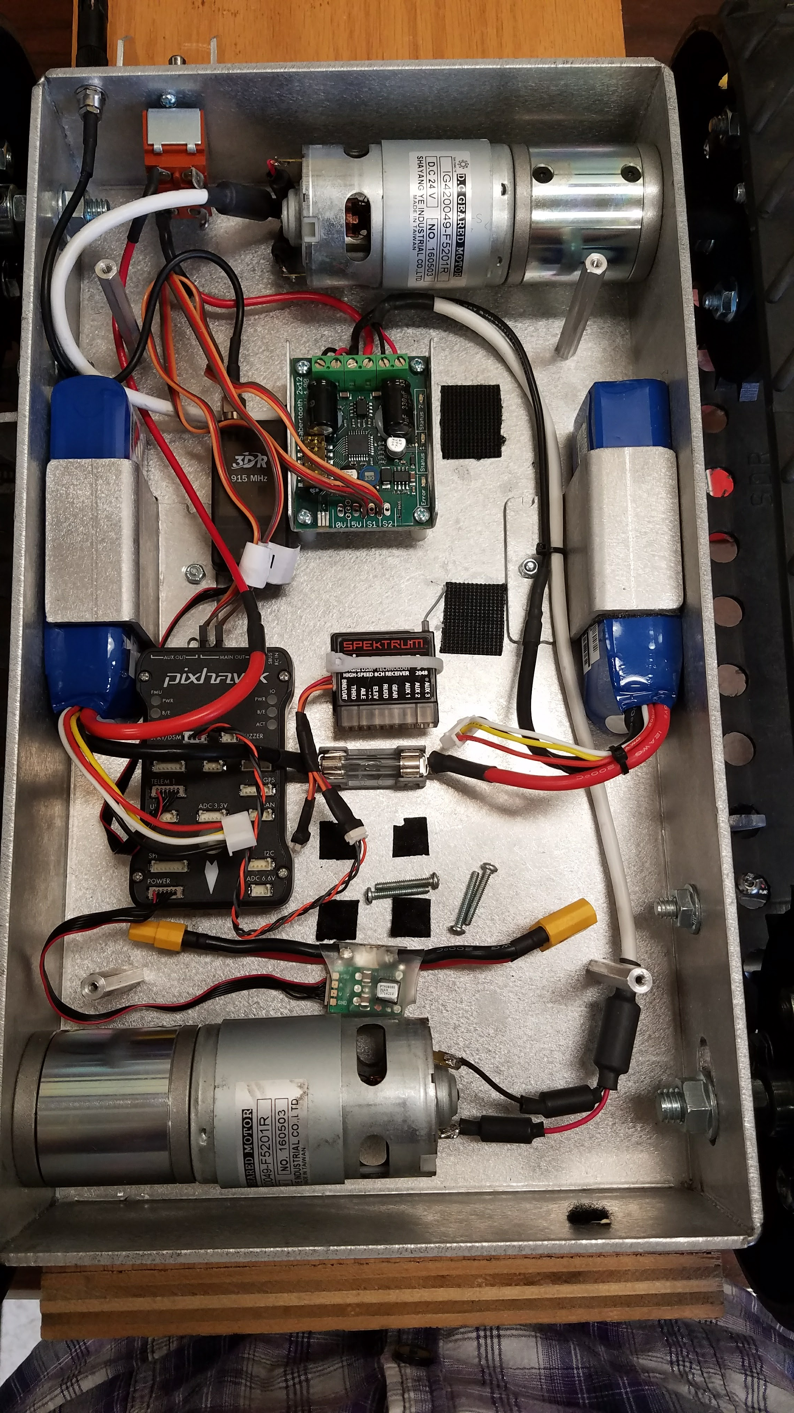
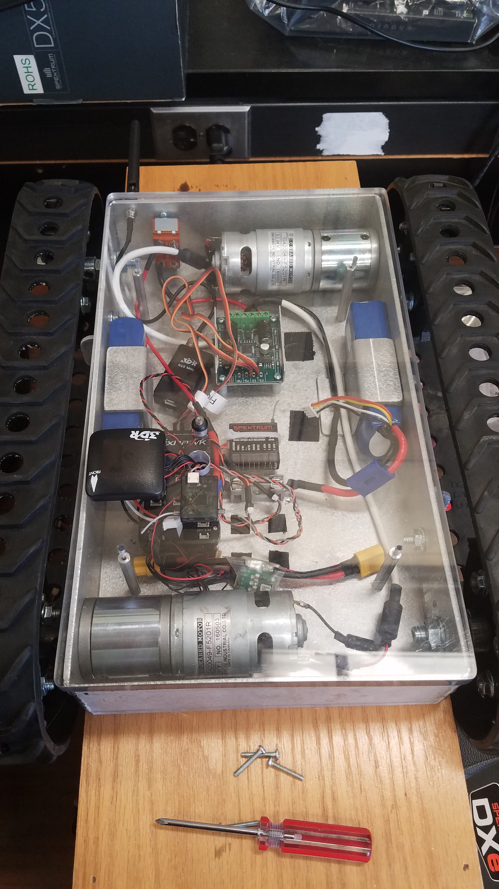
Updated the connectors on the smallest rover so batteries can be charged!

Slide 3
Status
Last Week:
Coming up:
Worked with Ryan to gather RSSI information from the Pixhawk system – ran into some issues (to be discussed by Ryan)
Got the middle-sized rover set up & running.
Took the smallest rover out and had it running around outside. Batteries were charged (2x 3s-LiPo).
Did some research into Google’s path planning algorithm & python libraries.
Alternate RSSI information from HackerRF with Ryan.
Continue looking into Python path planning libraries & start developing preliminary algorithm.
Progress on first URS Installment (due October 30th).
Remember: Mandatory URS Orientation on October 19th (not 12th).

Slide 4
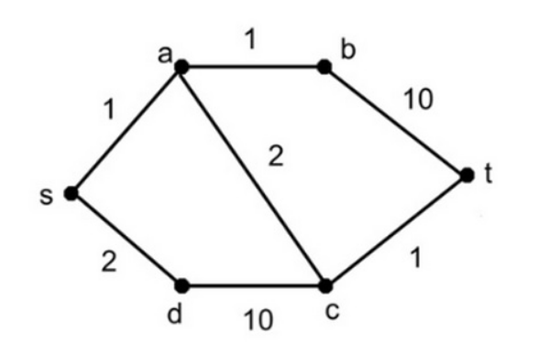
Path Planning
The path planning algorithm used by Google is “Dijkstra’s algorithm” which takes as input a graph of nodes, beginning node, and end node. Weights can be assigned to the paths between nodes as desired (distance, average RSSI, etc.)
One Python library that implements this algorithm is “Dijkstar,” which accepts an optional cost function to be called each implementation. It looks like this could be modified to give average RSSI for each path.
Another library that does a shortest path search is “Python-graph,” although it might not be very configurable.

Slide 5
Questions
Considerations when we implement path planning for our rover project: Do we always assume we are traveling at one speed? (Are we averaging RSSI over distance or time?) It would be a good simplification to not consider time in this algorithm.
How to import graphs into the Python libraries – this will require RSS data to be collected. How will nodes/paths work with lots of data points? *Requires interfacing my code with data collected by other programs.* What is the smallest distinguishable path for the rovers? This will likely impact node selection.

